Slide 1

CSE 3121
Database Management Systems
Session: 2016-17
Dr. Asif Zaman
Associate Professor, CSE, RU
Week # 1

Slide 2
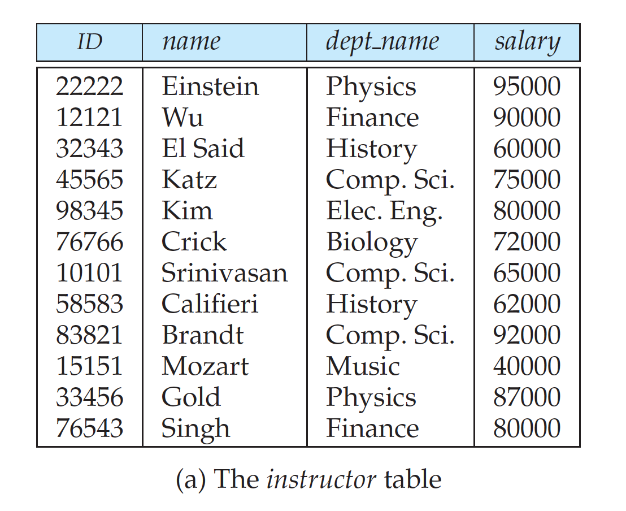
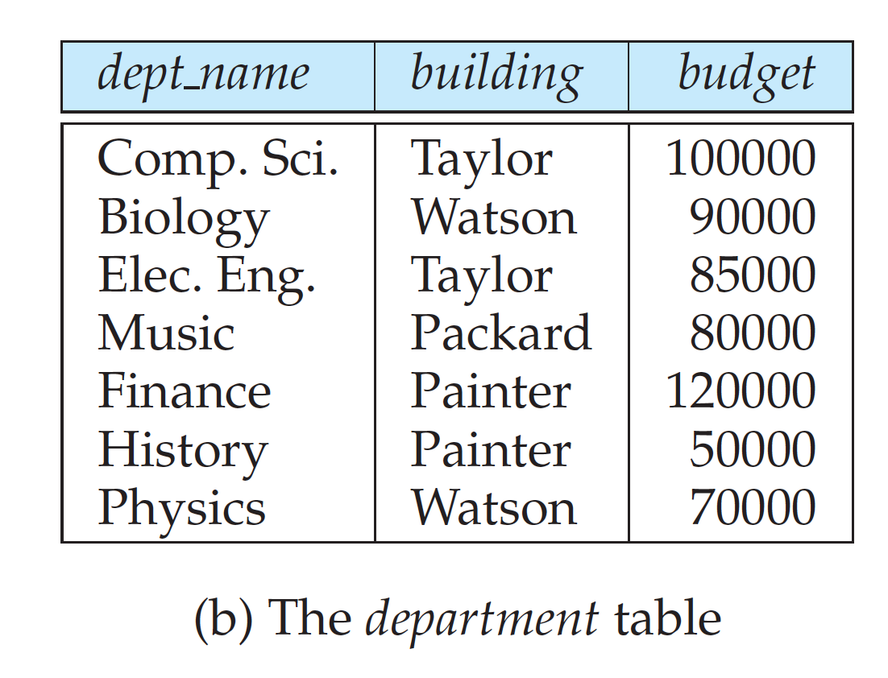
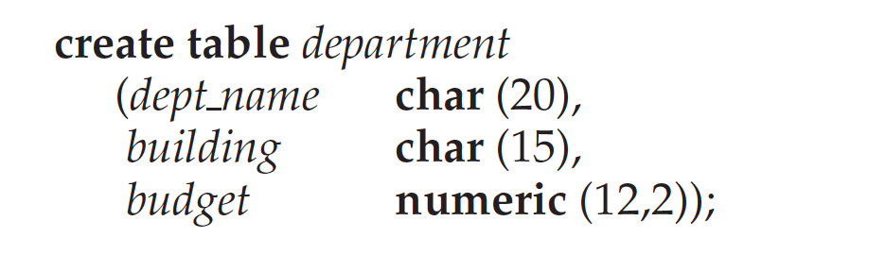
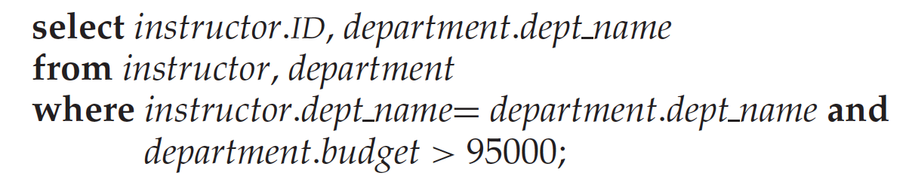

#DML:

Slide 3
Database Design
Database design mainly involves the design of the database schema.
The design of a complete database application environment that meets the needs of the enterprise being modeled requires attention to a broader set of issues.
The database designer needs to interact extensively with domain experts and users to carry out this task.
The outcome of this phase is a specification of user requirements.
Next, the designer chooses a data model, and by applying the concepts of the chosen data model, translates these requirements into a conceptual schema of the database.

Slide 4
Database Design
The designer can also examine the design to remove any redundant features.
The focus at this point is on describing the data and their relationships, rather than on specifying physical storage details
In terms of the relational model:
the conceptual-design process involves decisions on what attributes we want to capture in the database and how to group these attributes to form the various tables
The “how” part is mainly a computer-science problem.

Slide 5
Database Design
There are principally two ways to tackle the problem:
The first one is to use the entity-relationship model;
the other is to employ a set of algorithms (collectively known as normalization) that takes as input the set of all attributes and generates a set of tables.
A fully developed conceptual schema indicates the functional requirements of the enterprise.

Slide 6
Database Design
In a specification of functional requirements, users describe:
the kinds of operations (or transactions) that will be performed on the data.
Example operations include:
modifying or updating data, searching for and retrieving specific data, and deleting data.
At this stage of conceptual design, the designer can review the schema to ensure it meets functional requirements.

Slide 7
Database Design
The process of moving from an abstract data model to the implementation of the database proceeds in two final design phases:
The Logical-Design Phase, the designer maps the high-level conceptual schema onto the implementation data model of the database system that will be used.
The designer uses the resulting system-specific database schema in the sub sequent Physical-design phase, in which the physical features of the database are specified.

Slide 8
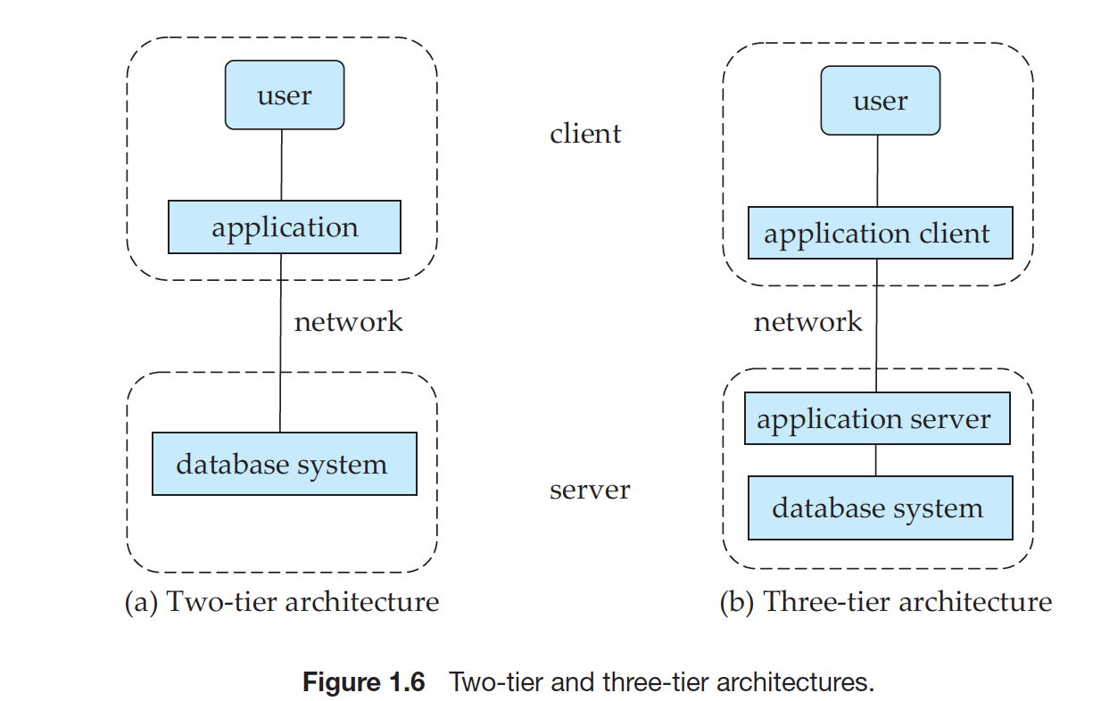
2-Tier & 3-Tier Architectures

Slide 9
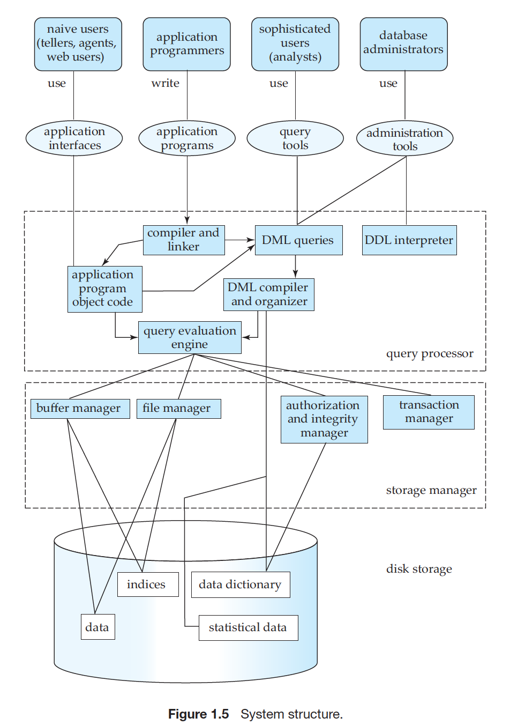


Slide 10

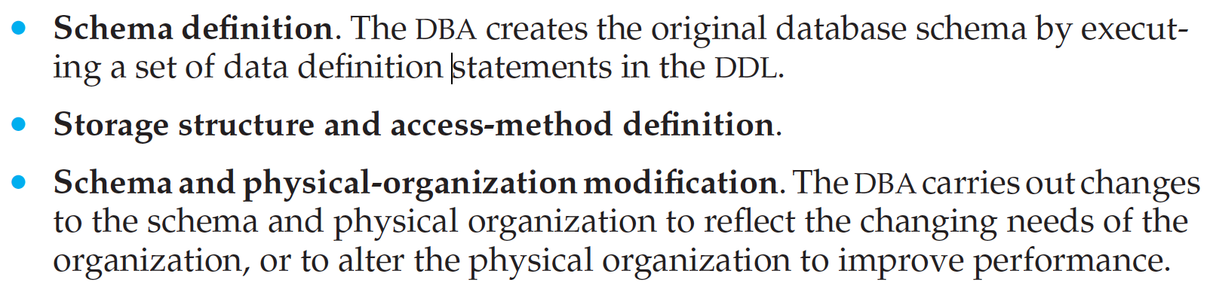
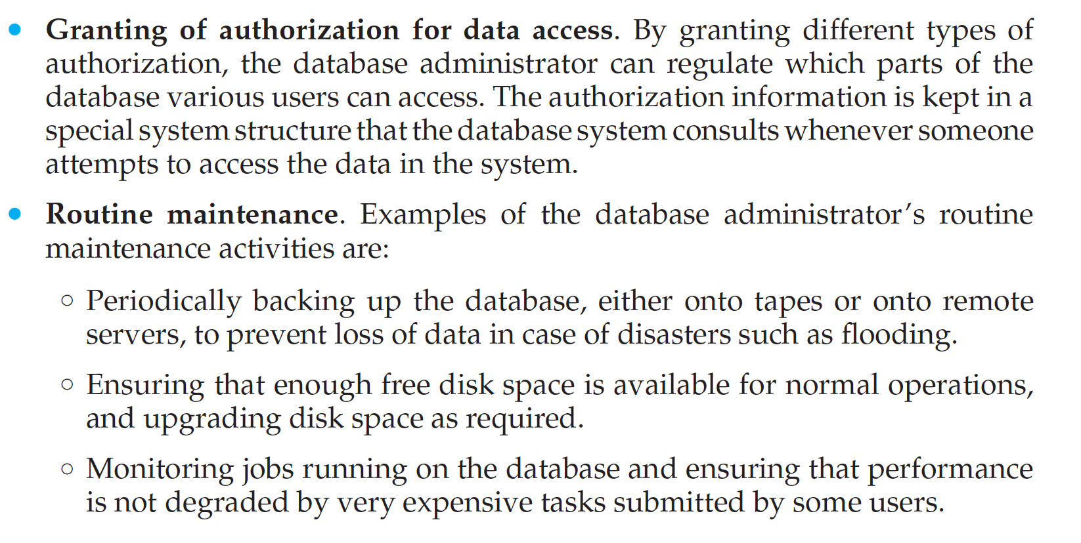

Slide 11
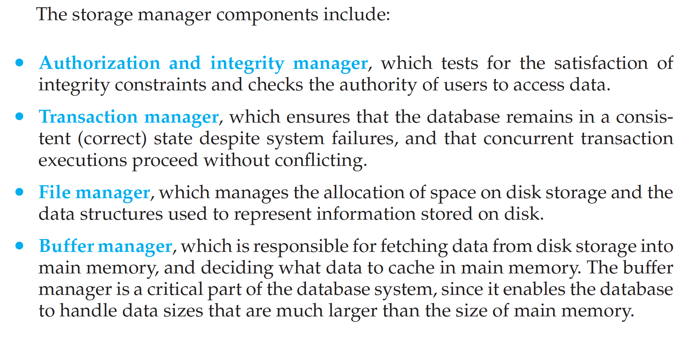
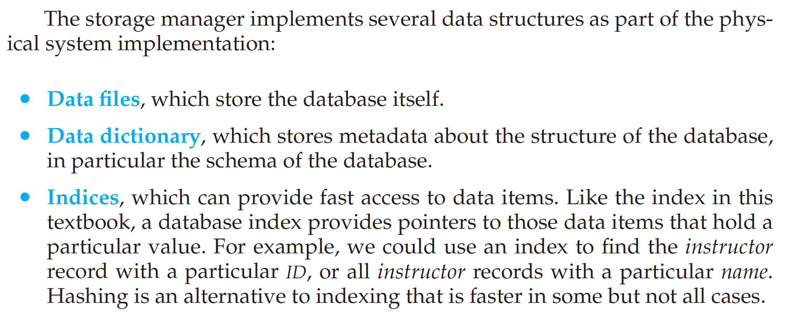
The functional components of a database system can be broadly divided into the:
storage manager and
the query processor components.

Slide 12
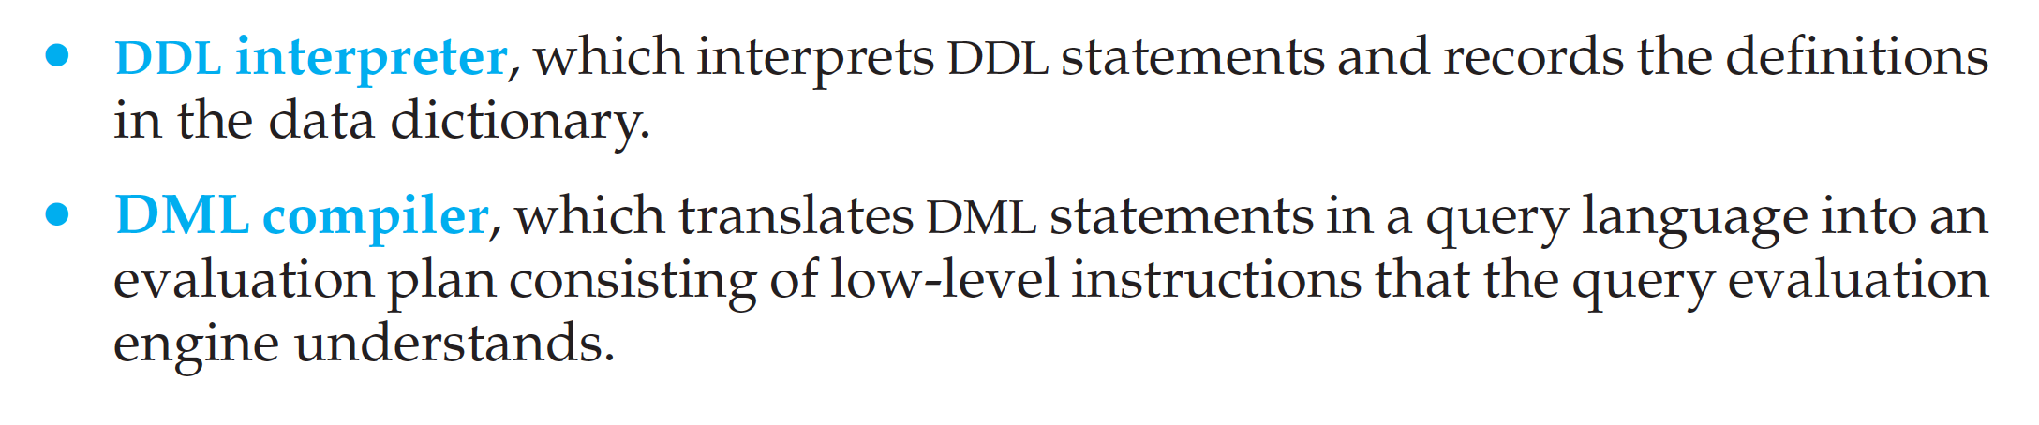
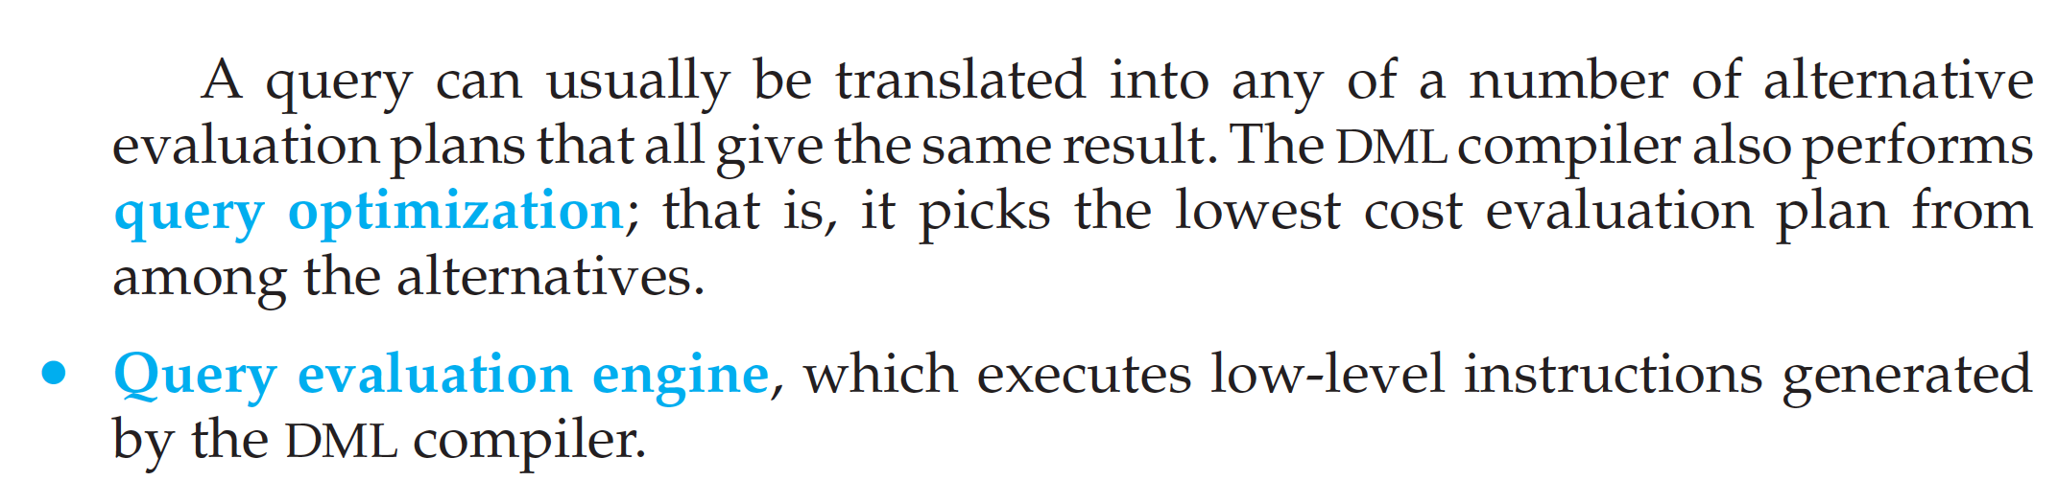

This all-or-none requirement is called atomicity

